Slide 1
Lab Azure #2
Stream processing with Azure Stream Analytics
Ref: https://github.com/Azure/MLAKSDeployment
https://docs.microsoft.com/en-us/azure/architecture/reference-architectures/data/stream-processing-stream-analytics

Slide 2
Stream processing with Azure Stream Analytics
This reference architecture shows an end-to-end stream processing pipeline. The pipeline ingests data from two sources, correlates records in the two streams, and calculates a rolling average across a time window. The results are stored for further analysis.

Slide 3
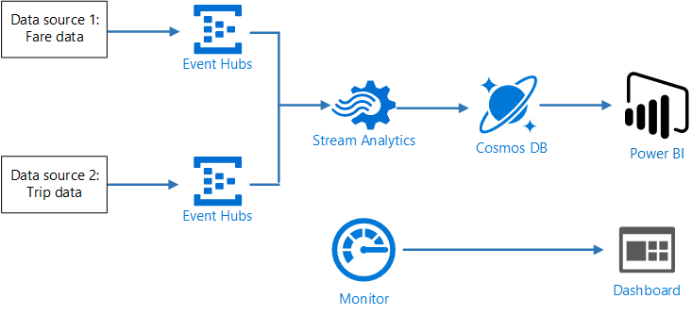
Stream processing with Azure Stream Analytics
Scenario: A taxi company collects data about each taxi trip. For this scenario, we assume there are two separate devices sending data. The taxi has a meter that sends information about each ride — the duration, distance, and pickup and dropoff locations. A separate device accepts payments from customers and sends data about fares. The taxi company wants to calculate the average tip per mile driven, in real time, in order to spot trends.

Slide 4
Stream processing with Azure Stream Analytics
1. Data Ingestion
To simulate a data source, this reference architecture uses the New York City Taxi Data dataset[1]. This dataset contains data about taxi trips in New York City over a 4-year period (2010 – 2013). It contains two types of record: Ride data and fare data.
Ride data includes trip duration, trip distance, and pickup and dropoff location
Fare data includes fare, tax, and tip amounts.
Common fields in both record types include medallion number, hack license, and vendor ID.
Together these three fields uniquely identify a taxi plus a driver. The data is stored in CSV format.

Slide 5
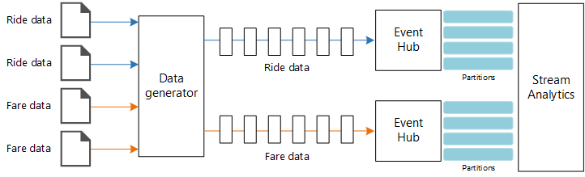
Stream processing with Azure Stream Analytics
1. Data Ingestion
In this particular scenario, ride data and fare data should end up with the same partition ID for a given taxi cab. This enables Stream Analytics to apply a degree of parallelism when it correlates the two streams. A record in partition n of the ride data will match a record in partition n of the fare data.

Slide 6
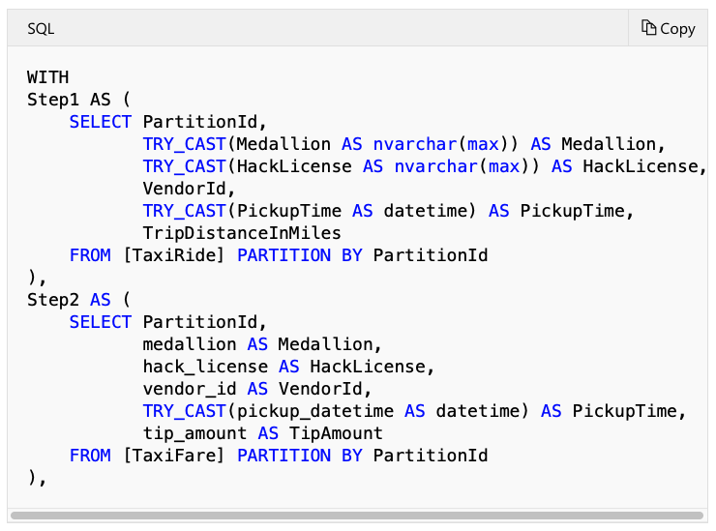
Stream processing with Azure Stream Analytics
2. Stream Processing
The stream processing job is defined using a SQL query with several distinct steps. The first two steps simply select records from the two input streams.

Slide 7
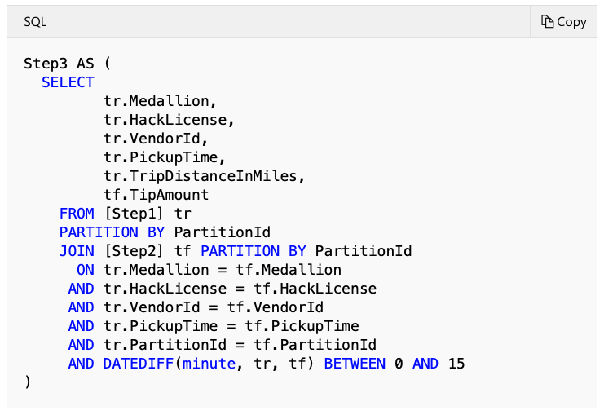
Stream processing with Azure Stream Analytics
2. Stream Processing
The next step joins the two input streams to select matching records from each stream.
This query joins records on a set of fields that uniquely identify matching records (Medallion, HackLicense, VendorId, and PickupTime). The JOIN statement also includes the partition ID. As mentioned, this takes advantage of the fact that matching records always have the same partition ID in this scenario.

Slide 8
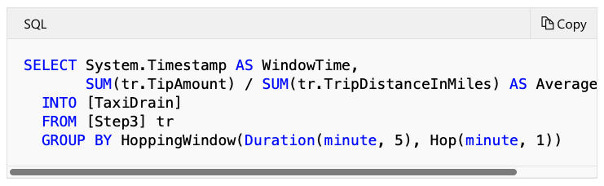
Stream processing with Azure Stream Analytics
2. Stream Processing
In Stream Analytics, joins are temporal, meaning records are joined within a particular window of time. Otherwise, the job might need to wait indefinitely for a match. The DATEDIFF function specifies how far two matching records can be separated in time for a match.
The last step in the job computes the average tip per mile, grouped by a hopping window of 5 minutes.

Slide 9
Stream processing with Azure Stream Analytics
3. Monitoring considerations
With any stream processing solution, it's important to monitor the performance and health of the system. Azure Monitor collects metrics and diagnostics logs for the Azure services used in the architecture. Azure Monitor is built into the Azure platform and does not require any additional code in your application.
Any of the following warning signals indicate that you should scale out the relevant Azure resource:
Event Hubs throttles requests or is close to the daily message quota.
The Stream Analytics job consistently uses more than 80% of allocated Streaming Units (SU).
Cosmos DB begins to throttle requests.

Slide 10
Stream processing with Azure Stream Analytics
Deploy the solution
Prerequisites
Clone, fork, or download the zip file for this repository.
Install Azure CLI 2.0.
Install the Azure building blocks npm package.
npm install -g @mspnp/azure-building-blocks
From a command prompt, bash prompt, or PowerShell prompt, sign into your Azure account as follows:

Slide 11
Stream processing with Azure Stream Analytics
Deploy the solution
Download the source data files
Create a directory named DataFile under the data/streaming_asa directory in the GitHub repo.
Open a web browser and navigate to https://uofi.app.box.com/v/NYCtaxidata/folder/2332219935.
Click the Download button on this page to download a zip file of all the taxi data for that year.
Extract the zip file to the DataFile directory.
This zip file contains other zip files. Don't extract the child zip files.

Slide 12
Stream processing with Azure Stream Analytics
Deploy the solution
Deploy the Azure resources
From a shell or Windows Command Prompt, run the following command and follow the sign-in prompt:
Navigate to the folder data/streaming_asa in the GitHub repository
Run the following commands to deploy the Azure resources:
In the Azure portal, navigate to the resource group that was created.
Open the blade for the Stream Analytics job.
Click Start to start the job. Select Now as the output start time. Wait for the job to start.

Slide 13
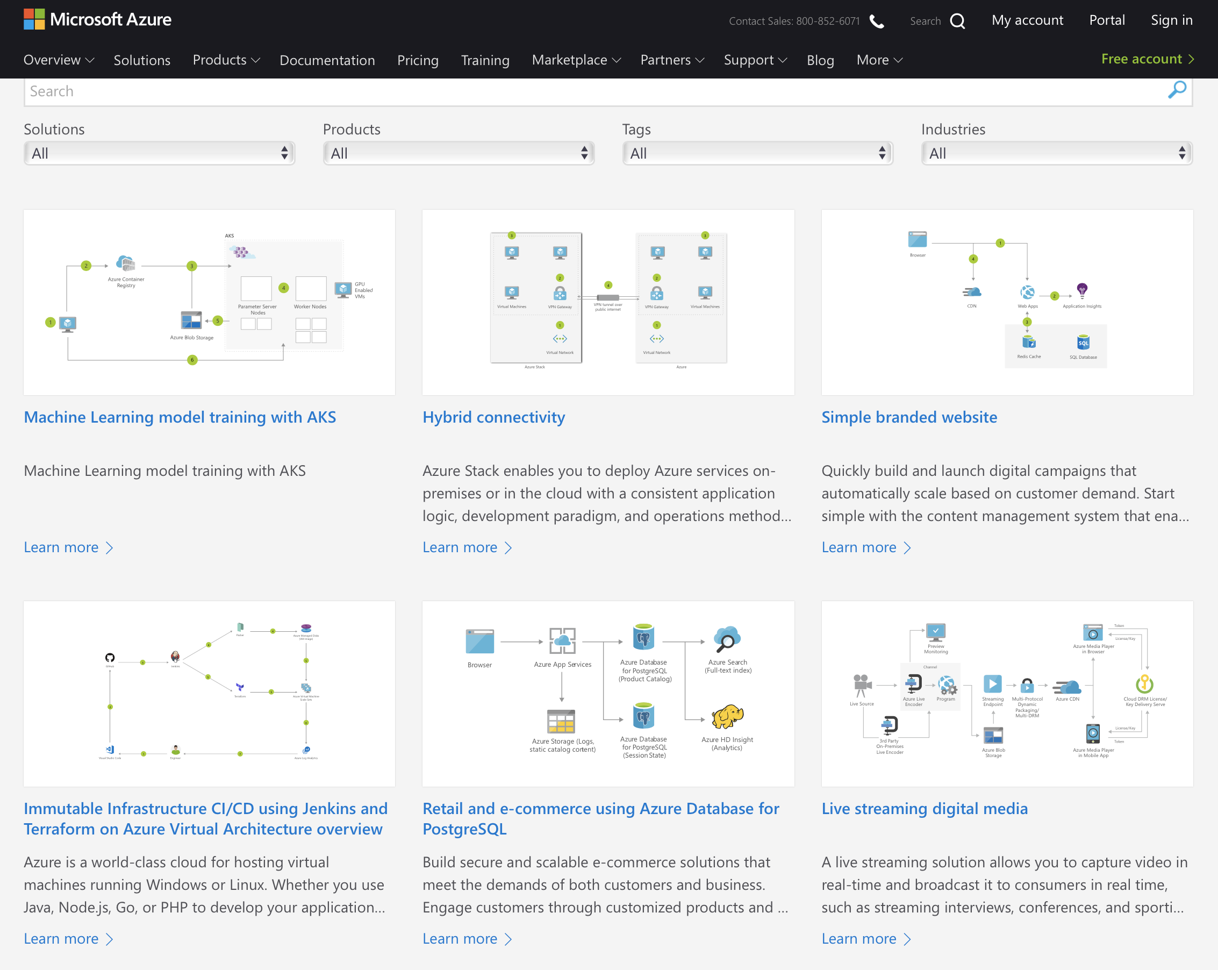
Deploying Python Models on a Kubernetes Clusters for Real-Time Scoring
https://azure.microsoft.com/en-us/solutions/architecture/

Slide 14
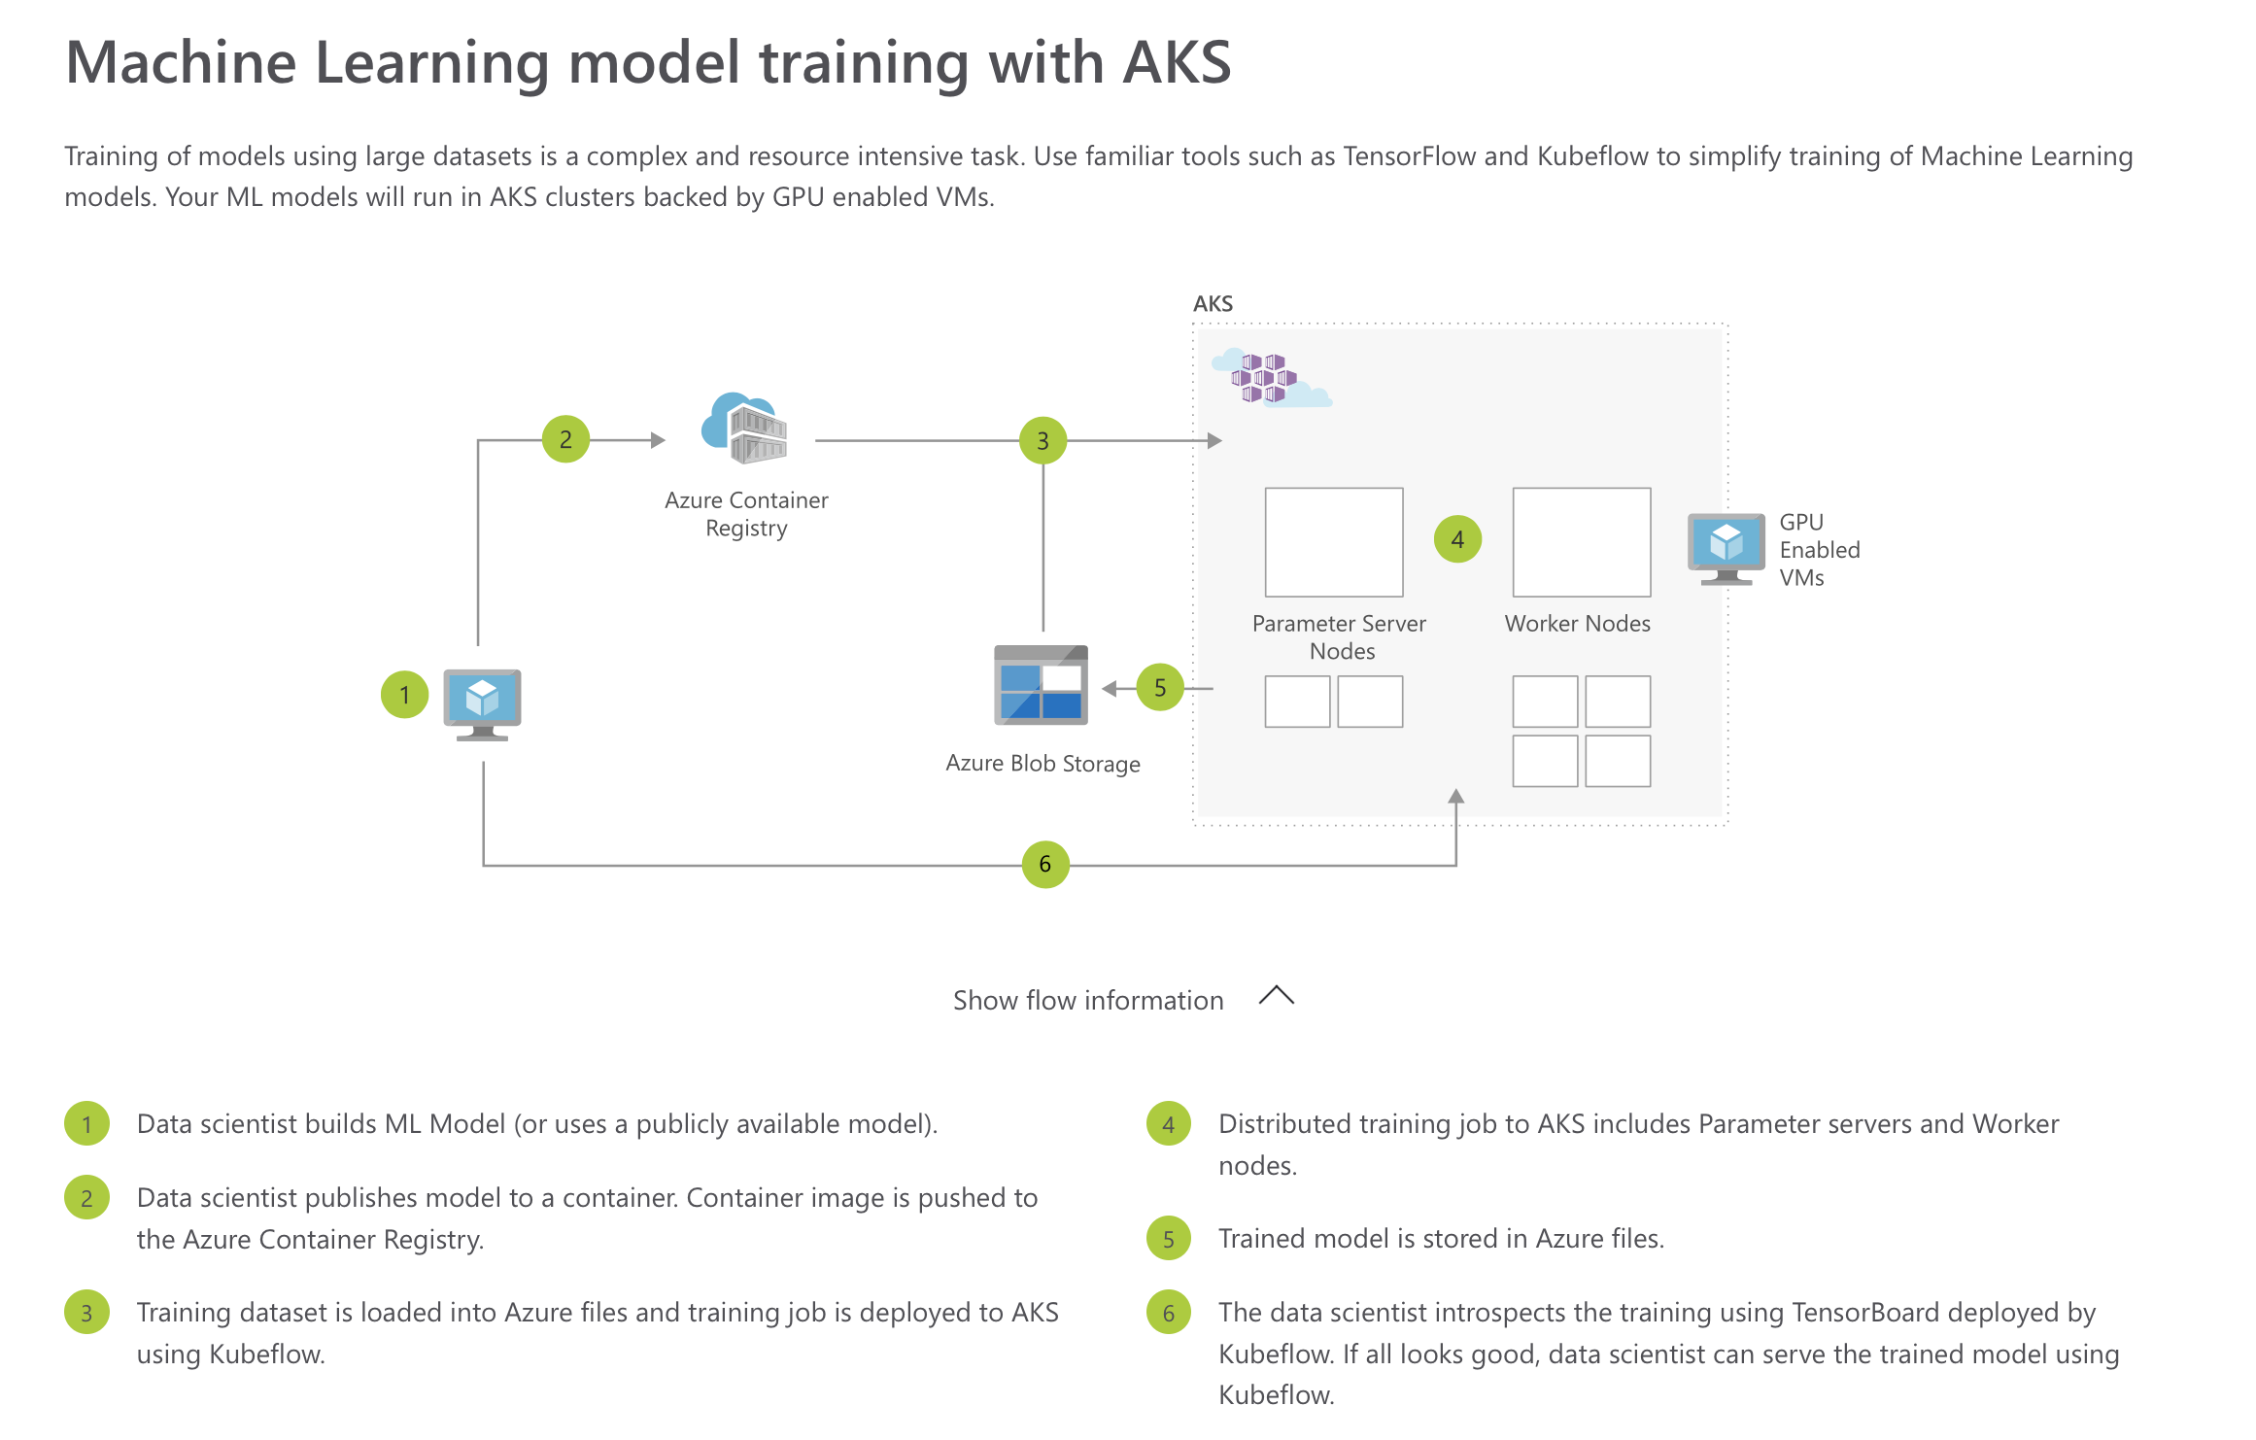
Deploying Python Models on a Kubernetes Clusters for Real-Time Scoring
https://azure.microsoft.com/en-us/solutions/architecture/

